Slide 1
Finance: Loan Default Prediction
Final Project

Slide 2
The Dataset
Age | Gender | Income | Employment Status | Location | Credit Score | Debt to Income Ratio | Existing Loan Balance | Loan Status | Loan Amount | Interest Rate | Loan Duration Months
56 | Male | 71266.105175 | Employed | Suburban | 639 | 0.007142 | 27060.188289 | Non-Default | 13068.330587 | 18.185533 | 59
46 | NaN | 37283.054601 | Employed | Suburban | 474 | 0.456731 | 40192.994312 | Default | 15159.338369 | 11.727471 | 69
32 | Male | 69567.036392 | Employed | Urban | 750 | 0.329231 | 25444.262759 | Default | 6131.287659 | 17.030462 | 69

Slide 3
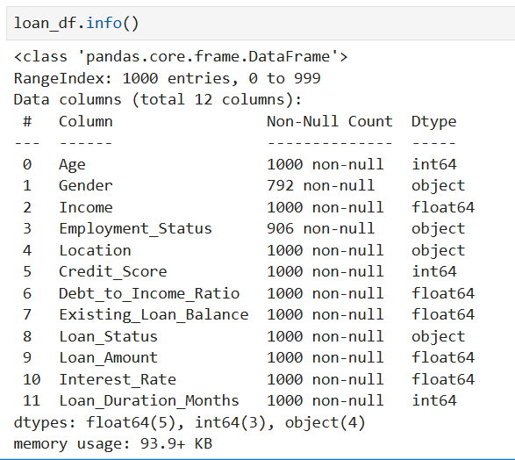
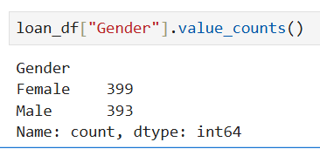
The Gender and Employment Status
Column had null values.
I filled the Gender null values alternatively
with Male and Female

Slide 4
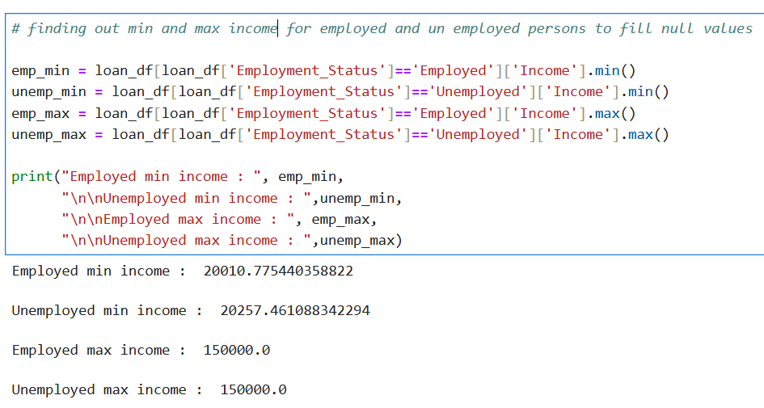
Filling Employment Status Nan Cells
Using this code,
I discovered that the minimum income
for unemployed individuals is higher
than that of employed individuals.
I used the average of the median salaries
of unemployed and employed individuals
as a threshold.
Then, I classified those
below the threshold as unemployed and
those above it as employed

Slide 5
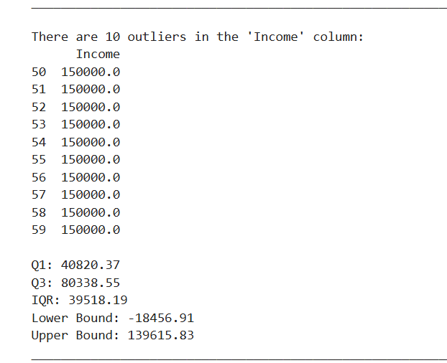
Outliers
Using the IQR values,
I identified 10 outliers in the Income column.
However, after removing them,
I noticed a significant drop in the model's accuracy.
As a result, I decided to leave the outliers unchanged.
No other columns contain any outliers.

Slide 6
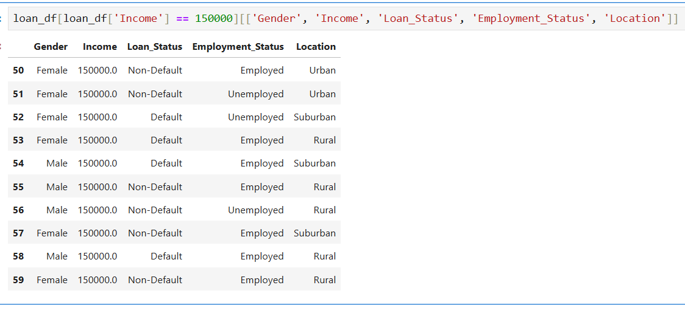
10 Outliers in Income
This makes it clear that the outliers are nearly
evenly distributed across employed and unemployed
individuals, as well as by gender and location.

Slide 7
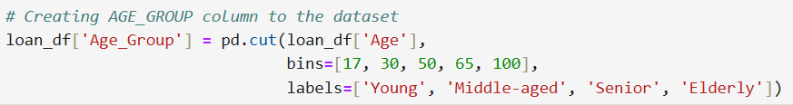
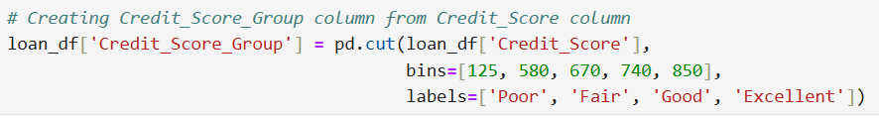
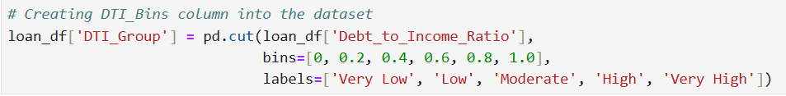
Adding extra features for better prediction
With these codes,
I have added six new features (columns)
to the DataFrame
to enhance prediction accuracy.

Slide 8
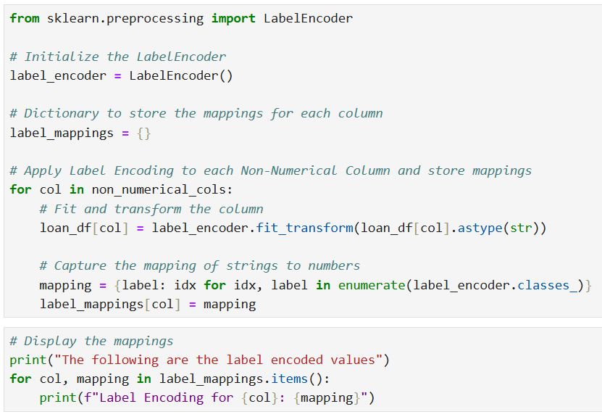
Label Encoding
With these codes,
I have LabelEncoded the non-numeric columns
to improve the model's prediction accuracy.

Slide 9
Data Normalization
I used OneHotEncoder to convert categorical values into 0's and 1's, followed by MinMaxScaler to normalize the data between 0 and 1, enhancing model prediction.
OneHotEncoder is used for categorical data, turning categories into numbers that models can use.
MinMaxScaler is used for numeric data, scaling it to a range (like 0 to 1) for consistency and to help models perform better.

Slide 10
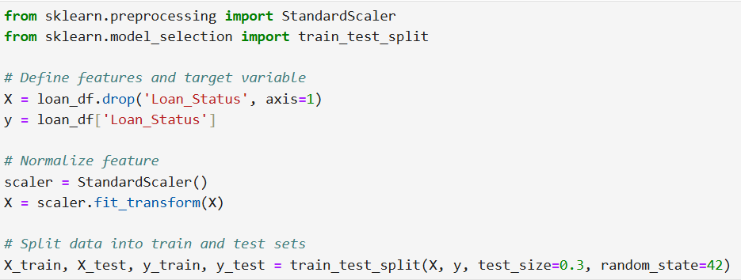
Train Test Split
After that, I used the TrainTestSplit function to divide the data into X_train, X_test, y_train, and y_test
for training and testing with separate datasets.

Slide 11
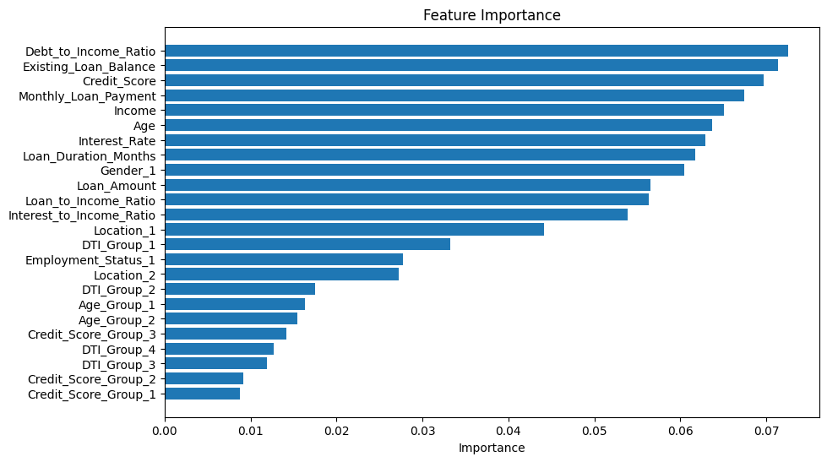
Feature Importance

Slide 12
Feature importance
The feature importance plot reveals that features such as Debt_to_Income_Ratio, Existing_Loan_Balance, Credit Score, Monthly_Loan_Payment, Income, and Age hold more significance. In contrast, the features DTI Group, Age Group, and Credit Score Group are less important. However, when I removed the less important features, the accuracy of the model decreased significantly. Therefore, I decided to retain all columns to ensure better accuracy and did not drop any features.

Slide 13
Model Training and Evaluation
Using the cleaned dataset, I trained
Logistic Regression
Decision Tree
Random Forest
SVM.
I found that Random Forest provided the best accuracy and a favorable ROC curve. After hyper-tuning the models for optimal parameters, the hyper-tuned Random Forest still yielded the highest accuracy and an impressive ROC curve.

Slide 14
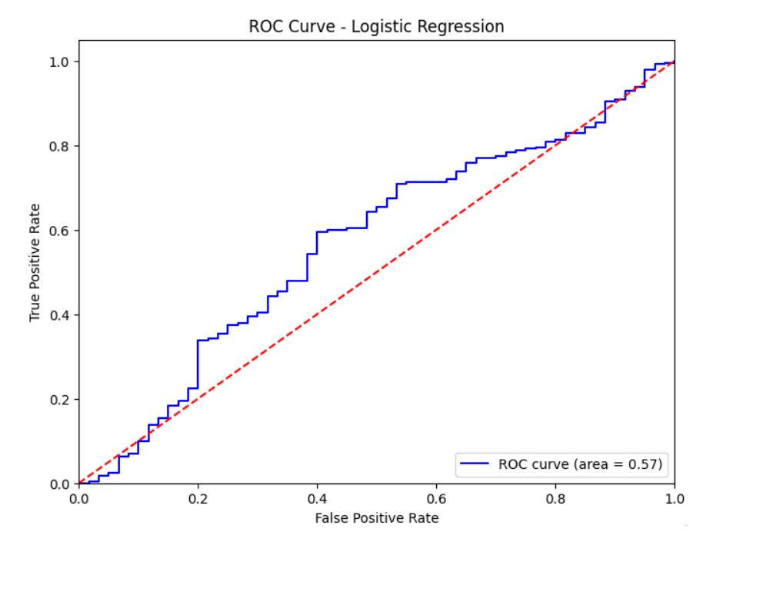
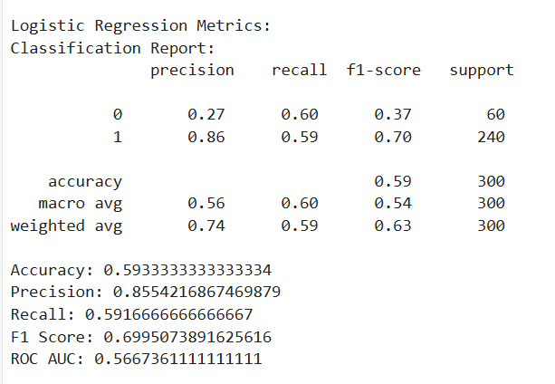
Default Logistic Regression

Slide 15
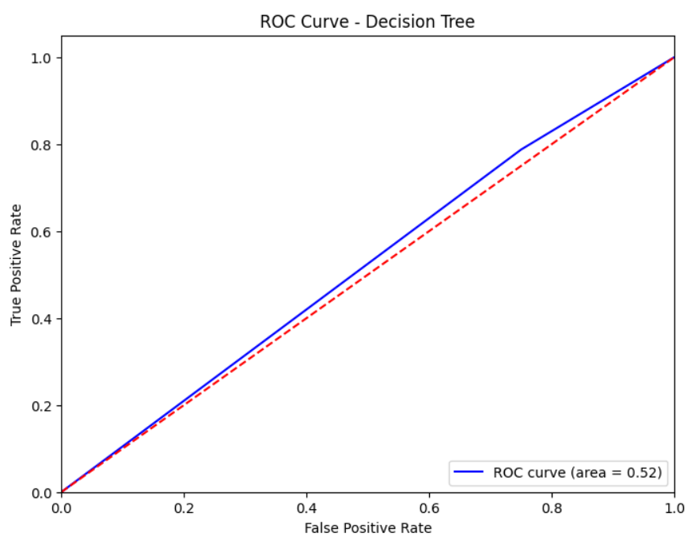
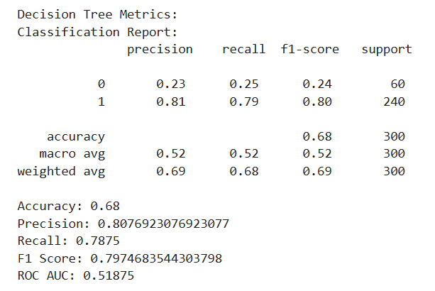
Default DecisionTree

Slide 16
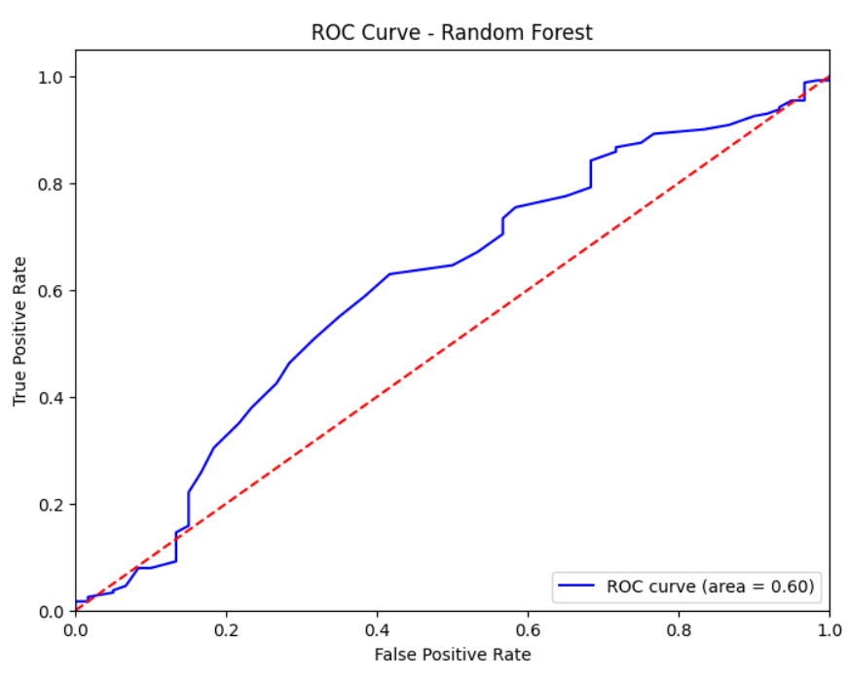
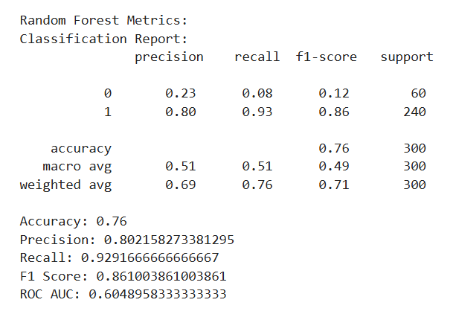
Default RandomForest

Slide 17
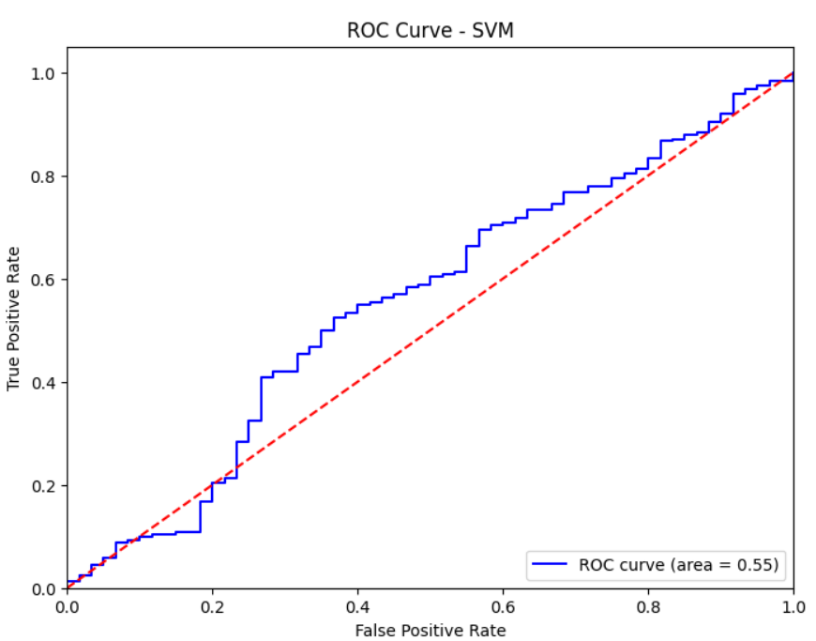
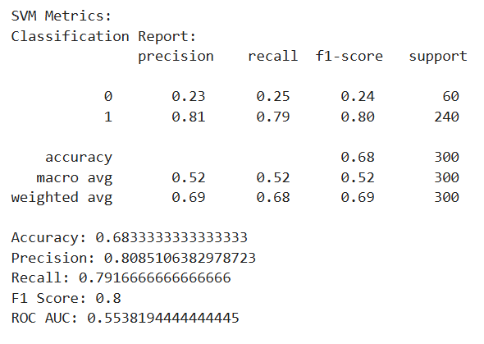
Default SVM

Slide 18
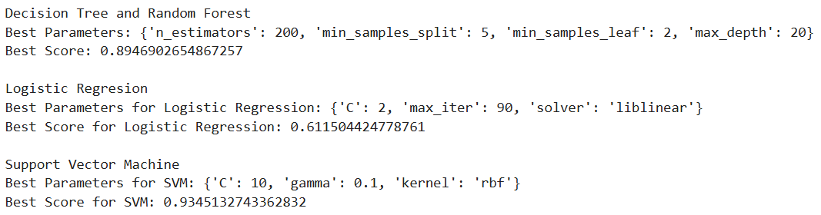
Hyper Tuned Values

Slide 19
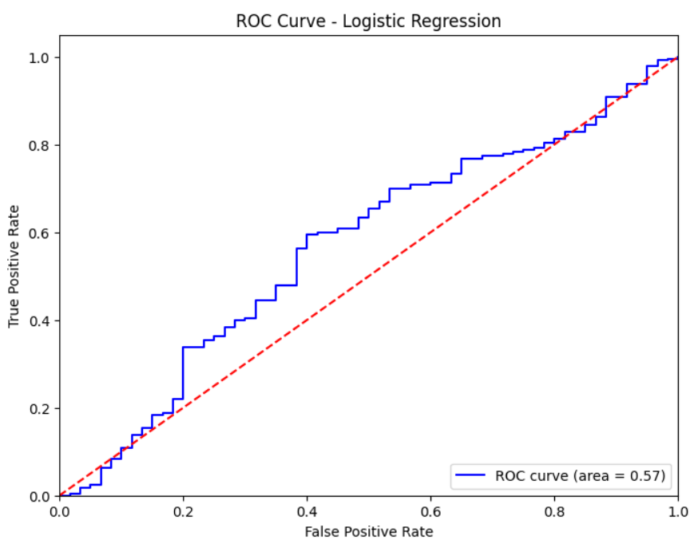
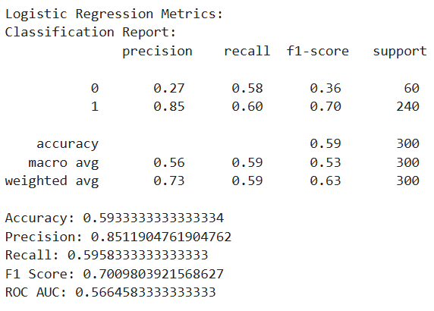
Hyper tuned Logistic Regression

Slide 20
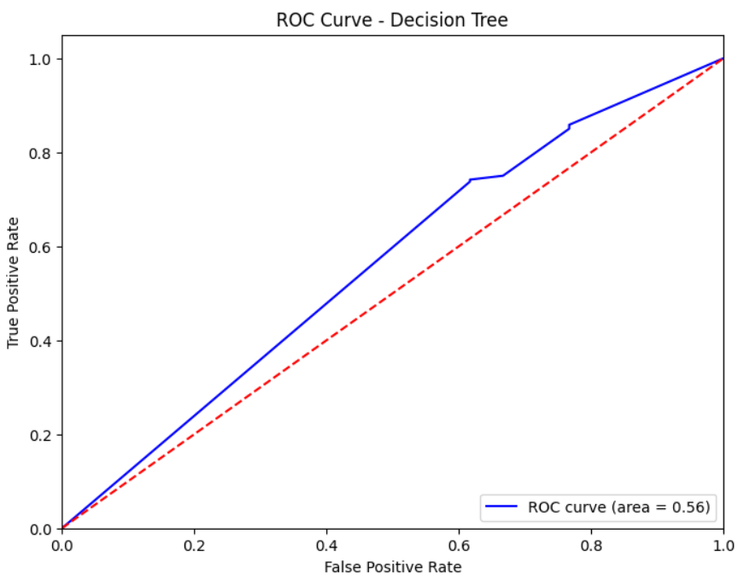
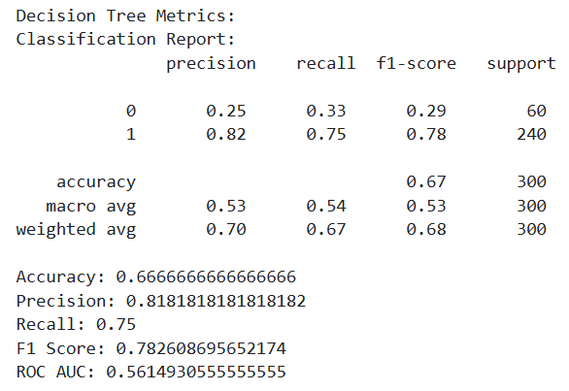
Hyper tuned DecisionTree

Slide 21
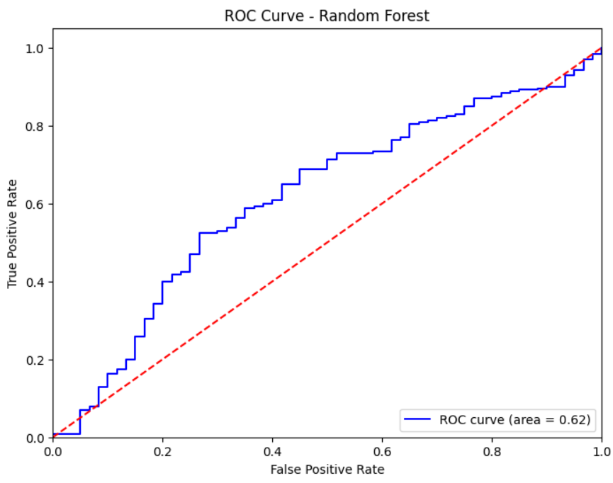
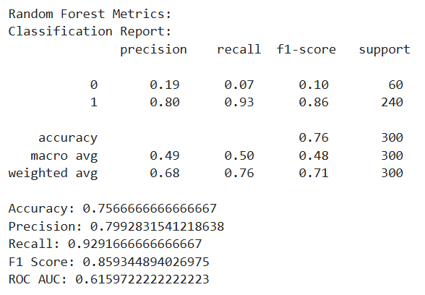
Hyper tuned RandomForest

Slide 22
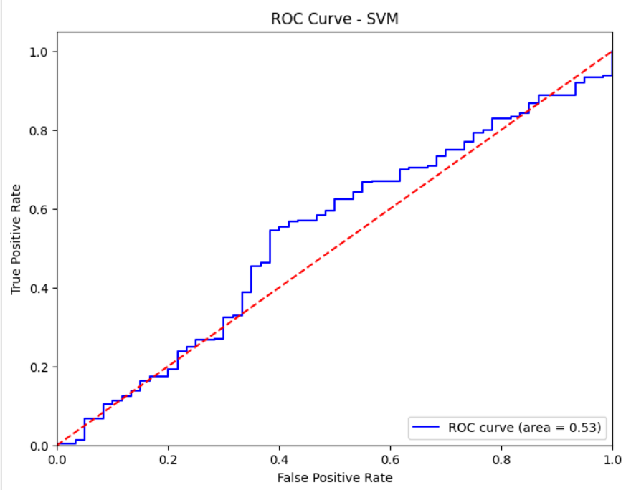
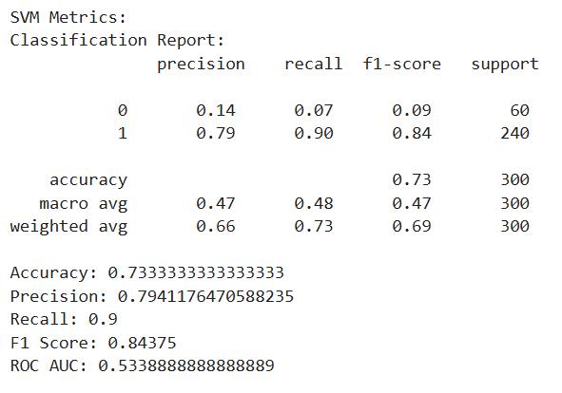
Hyper tuned SVM

Slide 23
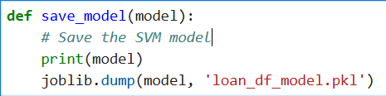
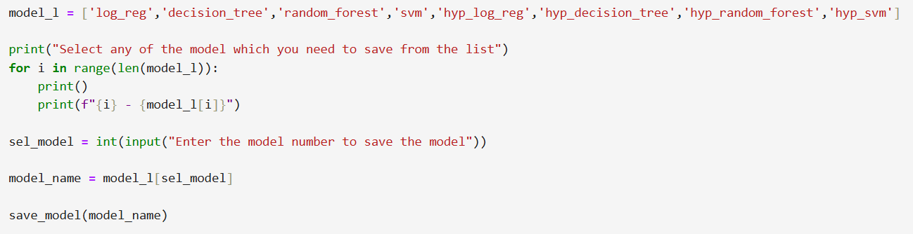
Saving the most accurate model
Since the hyper-tuned Random Forest is the most accurate model,
I saved it using the following code.

Slide 24
Findings after model building

Slide 25
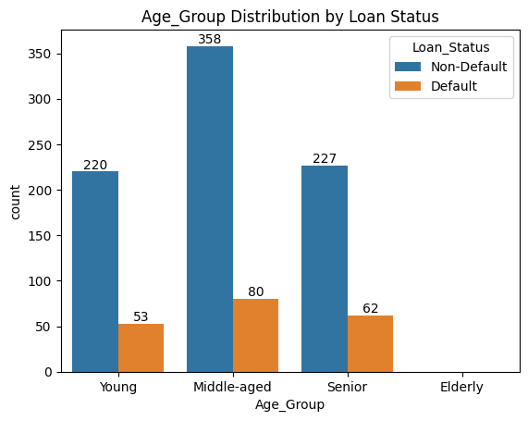
Age Group VS Loan Status
Middle-aged individuals are accessing more loans, with only 18% of them defaulting.
The loan default percentages are as follows:
Young : 19% - (Age : 17 - 30)
Middle age : 18% - (Age : 30 - 50)
Senior : 21% - (Age : 50 - 65)
Elderly : __% - (Age : 65 - 100)
There is no data on elderly individuals accessing loans, so bank can avoid targeting them for loan advertisements.
Additionally, extra caution is needed when approving loans for seniors, as their default rate is higher, which is 21%.

Slide 26
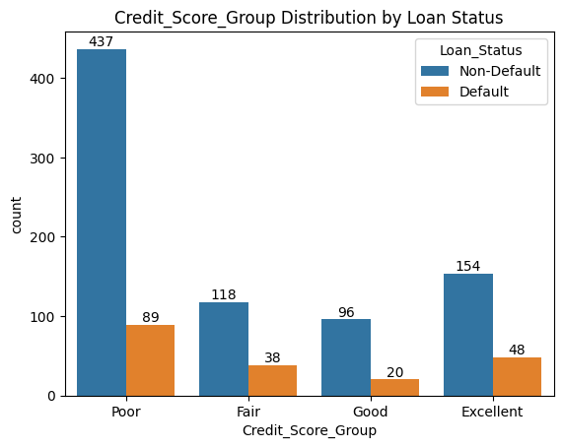
Credit Score VS Loan Status
People with poor credit scores are taking more loans, with only 16% of them defaulting.
The loan default percentages based on credit score are as follows:
Poor : 16% - (Credit Score : 125 to 580)
Fair : 24% - (Credit Score : 580 to 670)
Good : 17% - (Credit Score : 670 to 740)
Excellent : 23% - (Credit Score : 740 to 850)
Therefore, the bank should exercise caution when approving loans for individuals with Excellent and Fair credit scores.

Slide 27
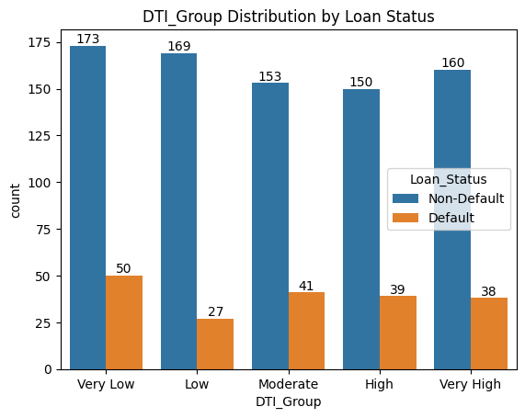
DTI Group VS Loan Status
The plot indicates that DTI scores are almost evenly distributed, with people having very low DTI values defaulting more frequently.
The loan default percentages based on DTI score are as follows:
Very low : 22% - (DTI score: 0.0 to 0.2)
Low : 13% - (DTI score: 0.2 to 0.4)
Moderate : 21% - (DTI score: 0.4 to 0.6)
High : 20% - (DTI score: 0.6 to 0.8)
Very High : 19% - (DTI score: 0.8 to 1.0)
As a result, the bank should be cautious when approving loans for individuals with very low and moderate DTI groups.

Slide 28
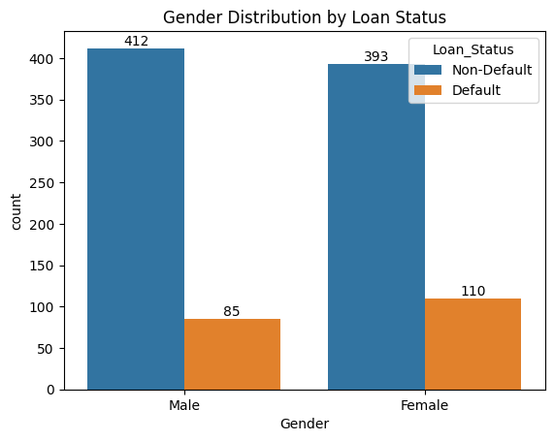
Gender VS Loan Status
The plot shows that both males and females are accessing loans in nearly equal numbers. However, the loan default rate is higher among female borrowers.
The loan default percentages by gender are as follows:
Male: 17%
Female: 21%
Therefore, the bank should exercise extra caution when approving loans for female borrowers.

Slide 29
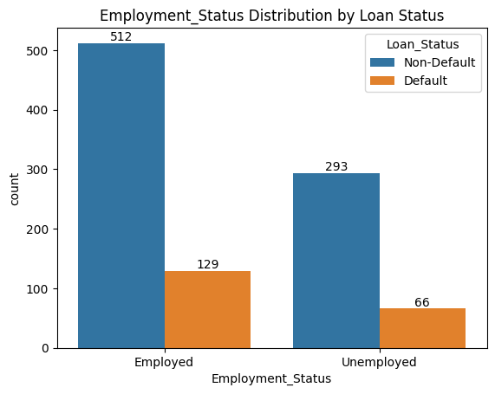
Employment Status VS Loan Status
The plot indicates that employed individuals are taking more loans, and the loan default rate is higher among employed borrowers.
The loan default percentages are as follows:
Employed: 20%
Unemployed: 18%
As a result, the bank should exercise extra caution when approving loans for employed borrowers.

Slide 30
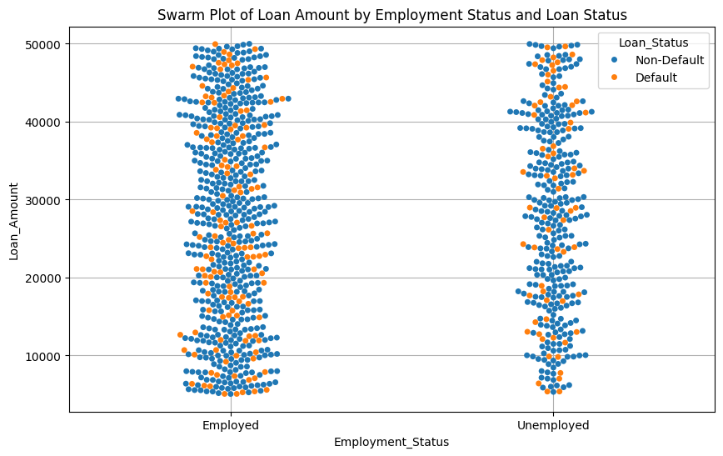
Employment Status and Loan Amount VS Loan Status
The swarm plot shows that loan defaults occur across all loan amounts, with no distinct differentiation between employed and unemployed individuals.

Slide 31
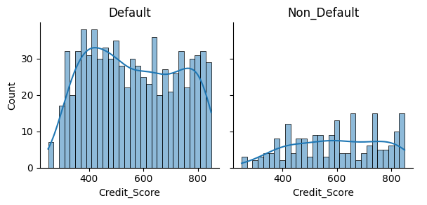
Credit Score VS Loan Status
Individuals with higher credit scores are defaulting more frequently compared to those with lower credit scores.
Individuals with credit scores between 350 and 450 are taking out more loans, yet their default rate is lower compared to those with credit scores above 550.
Therefore, the bank should focus more on individuals with credit scores between 350 and 450, as they are accessing more loans and exhibiting a lower default rate.

Slide 32
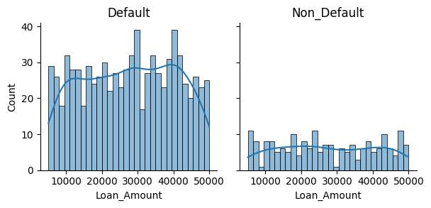
Loan Amount VS Loan Status
The plot indicates that a greater number of individuals are seeking loans between INR 25,000 and INR 45,000.
Therefore, the bank can concentrate more on offering loans within the above range.
Loan default rate is nearly equally distributed regardless of the loan amount.

Slide 33
Conclusion
Targeting Middle-aged Borrowers:
Middle-aged individuals (ages 30-50) show a relatively low default rate of 18%, making them a suitable demographic for loan approval. However, seniors (ages 50-65) present a higher risk with a default rate of 21%, indicating that extra caution should be exercised in this age group.
Avoiding the Elderly:
There is no data indicating elderly individuals (ages 65 and above) are accessing loans. Consequently, the bank can avoid targeting this demographic for loan advertisements, focusing on younger, more active borrowers.

Slide 34
Caution with Credit Scores:
Borrowers with poor credit scores (125-580) have a lower default rate of 16%, suggesting that this group can be considered for loans. However, those with fair (24% default rate) and excellent (23% default rate) credit scores present a higher risk, necessitating additional scrutiny before loan approval.
Attention to Debt-to-Income Ratios:
Individuals with very low DTI scores (0.0 to 0.2) exhibit a high default rate of 22%, indicating a significant risk. The bank should be cautious with this group while also paying attention to those with moderate DTI scores (0.4 to 0.6) who also show a high default rate of 21%.
Gender Considerations:
While male and female borrowers access loans in nearly equal numbers, female borrowers have a higher default rate of 21% compared to 17% for males. Therefore, the bank should exercise extra caution when approving loans for female applicants.

Slide 35
Employed Borrowers:
Employed individuals have a higher default rate of 20% compared to 18% for unemployed individuals. Hence, the bank should be vigilant in assessing the creditworthiness of employed borrowers.
Loan Amounts:
Despite varied demand for loan amounts, with a higher concentration between INR 25,000 and INR 45,000, the default rates are nearly equally distributed across all loan amounts. The bank should prioritize offering loans in this range but remain cautious, as the default risk does not significantly vary with the loan amount.
In summary:
while middle-aged individuals and those with poor credit scores can be targeted for loan approvals, seniors and female borrowers require careful assessment due to their higher default rates. The bank should also be vigilant about employed borrowers and those with very low DTI ratios. By adopting these strategies, the bank can optimize its lending practices and minimize potential risks associated with loan defaults.

Slide 36
Thank you for taking the time to review this report…
Disclaimer:
The findings presented in this report are based solely on statistical data analysis and are not intended to discriminate against any demographic or gender, emphasizing the need for fair and equitable loan approval practices.

